Slide 1
Natural Language Processing
CSCI 5832—Lecture 6
Jim Martin

Slide 2
Today
Text (Sequence) classification
Classification tasks
Naïve Bayes

Slide 3
After Class Today

Slide 4
Readings
Quiz 1 is on Tuesday 10/2
By then we will have covered
Chapters 2, 3, 4, 5, 6, 7, 8, and parts of Appendix A (HMMs)
The quizzes cover material from class and in the readings (the union not the intersection).

Slide 5
Urn Example
.6
.7
.4
Urn 1
Urn 2
.3
Let’s re-estimate the Urn1->Urn1 transition

Slide 6
Urns and Balls
Blue Blue Red
1 1 1 | (0.9*0.3)*(0.6*0.3)*(0.6*0.7)=0.0204
1 1 2 | (0.9*0.3)*(0.6*0.3)*(0.4*0.4)=0.0077
1 2 1 | (0.9*0.3)*(0.4*0.6)*(0.3*0.7)=0.0136
1 2 2 | (0.9*0.3)*(0.4*0.6)*(0.7*0.4)=0.0181
2 1 1 | (0.1*0.6)*(0.3*0.7)*(0.6*0.7)=0.0052
2 1 2 | (0.1*0.6)*(0.3*0.7)*(0.4*0.4)=0.0020
2 2 1 | (0.1*0.6)*(0.7*0.6)*(0.3*0.7)=0.0052
2 2 2 | (0.1*0.6)*(0.7*0.6)*(0.7*0.4)=0.0070

Slide 7
Urns and Balls
That’s
(2*.0204)+(1*.0077)+(1*.0052) = .0537
Again, not what we need but we’re closer… we just need to normalize using those two numbers.

Slide 8
Urns and Balls
The 1->2 transition probability is
.0414/(.0414+.0537) = 0.435
The 1->1 transition probability is
.0537/(.0414+.0537) = 0.565
So in re-estimation the 1->2 transition went up from .4 to .435 and the 1->1 transition went down from .6 to .565

Slide 9
EM Re-Estimation
Not done yet. No reason to think those values are right. They’re just more right than they used to be.
So do it again, and again and....
Until convergence
Convergence does not guarantee a global optima, just a local one
As with Problems 1 and 2, you wouldn’t actually compute it this way. Enumerating all the paths is infeasible.

Slide 10
The Point
Given an untagged corpus and a fixed size tag set
You can automatically learn both the transition probabilities and the observation probabilities needed to create an HMM-based POS tagger.

Slide 11
Text Classification

Slide 12
Is This Spam?

Slide 13
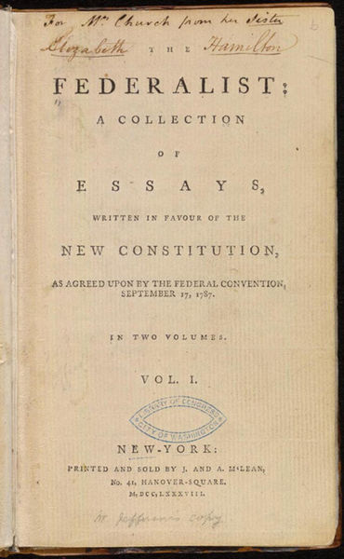
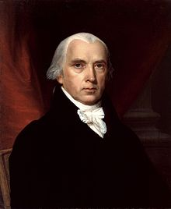
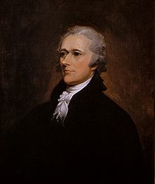
Who Wrote Which Federalist Paper?
1787-8: anonymous essays try to convince New York to ratify new U.S. Constitution: Jay, Madison, Hamilton.
Authorship of 12 of the letters in dispute
1963: solved by Mosteller and Wallace using Bayesian methods
James Madison
Alexander Hamilton

Slide 14
Author Gender?
Clara never failed to be astonished by the extraordinary felicity of her own name. She found it hard to trust herself to the mercy of fate, which had managed over the years to convert her greatest shame into one of her greatest assets…
In my younger and more vulnerable years my father gave me some advice that I’ve been turning over in my mind ever since.“Whenever you feel like criticizing any one,” he told me, “just remember that all the people in this world haven’t had the advantages that you’ve had.”
Notes:
#1: Saigon. Grey, Anthony
#2: Jerusalem the Golden. Drabble, Margaret
From shlomo argamon

Slide 15


Movie Review: Positive or Negative?
unbelievably disappointing
Full of zany characters and richly applied satire, and some great plot twists
this is the greatest screwball comedy ever filmed
It was pathetic. The worst part about it was the boxing scenes.

Slide 16
Multinomial: Article Topics
Journal Article
MeSH Subject Category Hierarchy
Antogonists and Inhibitors
Blood Supply
Chemistry
Drug Therapy
Embryology
Epidemiology
…
?

Slide 17
Text Classification
Input:
a document d
a fixed set of classes C = {c₁, c₂,…, c_{J}}
Output: a predicted class c ∈ C

Slide 18
Supervised Machine Learning
Input:
a document d
a fixed set of classes C = {c₁, c₂,…, c_{J}}
A training set of m hand-labeled documents (d₁,c₁),....,(d_{m},c_{m})
Output:
a learned classifier h(d) → c

Slide 19
Supervised Machine Learning
Any kind of classifier will do
Naïve Bayes
Logistic regression
Support-vector machines
Neural network

Slide 20
Naïve Bayes Intuition
Simple classification method based on Bayes rule and some naïve independence assumptions
Relies on very simple representation of documents
Bag of words

Slide 21
Bag of Words

Slide 22
Bayes Rule
For a document d and a class c

Slide 23
Naïve Bayes Classifier (1)
MAP is “maximum a posteriori” = most likely class
Bayes Rule
Dropping the denominator

Slide 24
Naïve Bayes Classifier (2)
Document d represented as features x1..xn

Slide 25
Naïve Bayes Classifier (3)
How often does this class occur?
O(|X|^{n}•|C|) parameters
We can just count the relative frequencies in a training corpus
Could only be estimated if a very, very large number of training examples was available.

Slide 26
Naïve Bayes Independence Assumptions
Bag of Words assumption: Assume position doesn’t matter
Conditional Independence: Assume the feature probabilities P(x_{i}|c_{j}) are independent given the class c.

Slide 27
Multinomial Naïve Bayes Classifier

Slide 28
Applying Naive Bayes to Text Classification
positions ← all word positions in test document

Slide 29
Learning a Naïve Bayes Model
First attempt: maximum likelihood estimates
Simply use the frequencies in the data

Slide 30
Parameter Estimation
Fraction of times word w_{i} appears
among all words in documents of topic c_{j}
Create one large document for topic j by concatenating all docs in this topic
Use frequency of w in mega-document

Slide 31
Problem with Maximum Likelihood
What if we have no training documents with the word fantastic and classified in the topic positive?
Zero probabilities cannot be conditioned away, no matter the other evidence!

Slide 32
Laplace Smoothing for Naïve Bayes

Slide 33
Multinomial Naïve Bayes: Learning (Counting)
From training corpus, extract Vocabulary
Calculate P(c_{j}) terms
For each c_{j} in C do
docs_{j} ← all docs with class =c_{j}
Calculate P(w_{k} | c_{j}) terms
Text_{j} ← single doc containing all docs_{j}
For each word w_{k} in Vocabulary
n_{k} ← # of occurrences of w_{k} in Text_{j}

Slide 34
Naïve Bayes and Language Modeling
Naïve bayes classifiers can use any sort of feature, not just the words
URL, email address, dictionaries, network features
But if, as in the previous slides
We use only word features
And we use all of the words in the text (not a subset)
Then
Naïve bayes has an important similarity to language modeling.

Slide 35
Unigram Language Model
Assigning each word: P(word | c)
Assigning each sentence: P(s|c)=Π P(word|c)
Class pos
0.1 I
0.1 love
0.01 this
0.05 fun
0.1 film
…
I
love
this
fun
film
0.1
0.1
.05
0.01
0.1
P(s | pos) = 0.0000005

Slide 36
Naïve Bayes as a Language Model
Which class assigns the higher probability to s?
Model pos
Model neg
0.2 I
0.001 love
0.01 this
0.005 fun
0.1 film
0.1 I
0.1 love
0.01 this
0.05 fun
0.1 film
I
love
this
fun
film
0.1
0.1
0.01
0.05
0.1
0.2
0.001
0.01
0.005
0.1
P(s|pos) > P(s|neg)

Slide 37
 | Doc | Words | Class
Training | 1 | Chinese Beijing Chinese | c
 | 2 | Chinese Chinese Shanghai | c
 | 3 | Chinese Macao | c
 | 4 | Tokyo Japan Chinese | j
Test | 5 | Chinese Chinese Chinese Tokyo Japan | ?
Priors:
P(c)=
P(j)=
3/4
Choosing a class:
P(c|d5)
P(j|d5)
1/4
3/4 * (3/7)³ * 1/14 * 1/14
≈ 0.0003
Conditional Probabilities:
P(Chinese|c) =
P(Tokyo|c) =
P(Japan|c) =
P(Chinese|j) =
P(Tokyo|j) =
P(Japan|j) =
(5+1) / (8+6) = 6/14 = 3/7
(0+1) / (8+6) = 1/14
(0+1) / (8+6) = 1/14
1/4 * (2/9)³ * 2/9 * 2/9
≈ 0.0001
(1+1) / (3+6) = 2/9
(1+1) / (3+6) = 2/9
(1+1) / (3+6) = 2/9

Slide 38
Practical Issues
Preventing underflow
Multiplying lots of probabilities can result in floating-point underflow.
log(xy) = log(x) + log(y)
Sum logs of probabilities instead of multiplying probabilities.
Class with highest un-normalized log probability score is still most probable.
Model is now just max of sum of weights

Slide 39
Machine Learning
This model is now essentially a sum of weighted features + a bias term
You can think of this as a scoring function
Moving on, we can move away from just word-based features and find better ways to set the weights

